Slide 1
Lead Score Case Study
Submitted by :
Raj Pratap Pandey
Sushma Mahagaonkar
Kaveri Namdeorao Deotkar

Slide 2
Problem Statement:
X Education offers online courses to industry professionals. The business promotes its courses on various websites and search engines such as Google.When these people arrive at the website, they may peruse the classes, fill out a course registration form, or watch some videos. These individuals are classified as leads when they fill out a form with their email address or phone number. Furthermore, the business receives leads from previous referrals.Once these leads are obtained, members of the sales team begin making calls, composing emails, and so on. Some leads are converted during this procedure, while the majority are not. At X education, the average offer conversion rate is around 30%.
Business Goal:
X Education requires assistance in identifying the most promising leads, i.e. those most likely to turn into paying customers.The business requires a model in which a lead score is assigned to each lead, with higher lead scores having a higher conversion chance and lower lead scores having a lower conversion chance.The CEO, in particular, has stated that the goal lead conversion rate should be around 80%.

Slide 3
Plan
Source the data for analysis
Clean and prepare the data
Exploratory Data Analysis.
Feature Scaling
Splitting the data into Test and Train dataset.
Building a logistic Regression model and calculate Lead Score.
Evaluating the model by using different metrics -Specificity and Sensitivity or Precision and Recall.
Applying the best model in Test data based on the Sensitivity and Specificity Metrics.

Slide 4
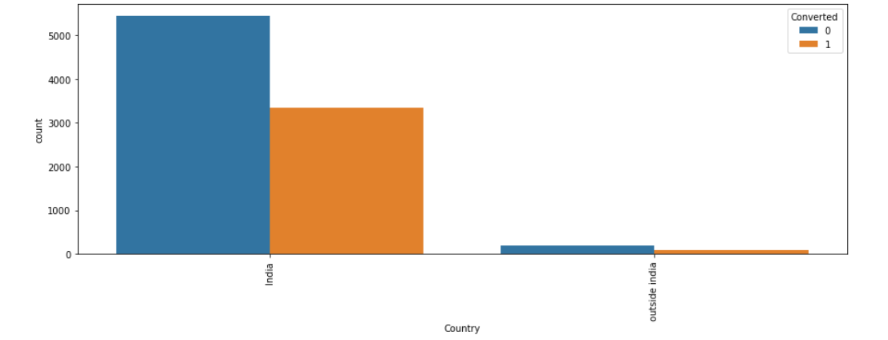
Exploratory Data Analysis
Given that India has a significant number of values
(nearly 97% of the data), this field can be removed

Slide 5
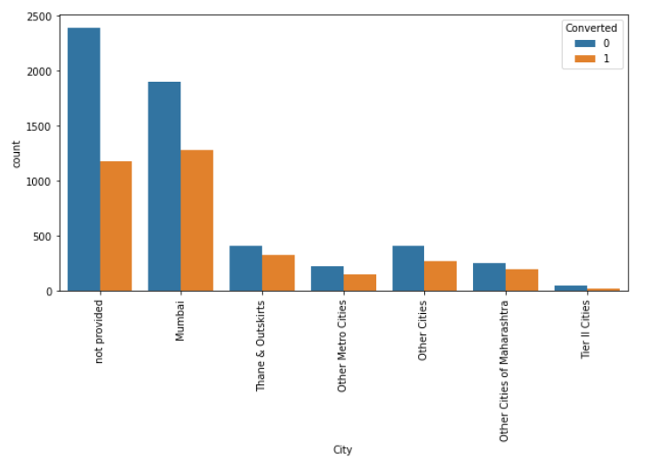
Plotting spread of City columnn after replacing NaN values

Slide 6
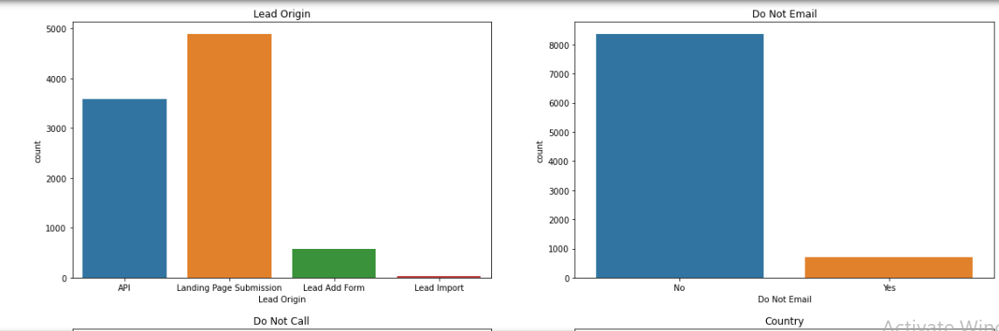
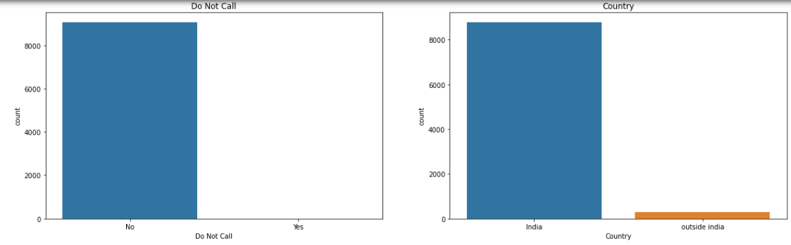

Slide 7
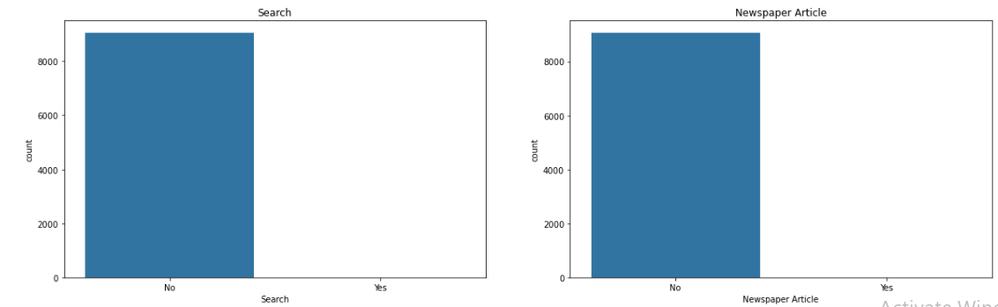
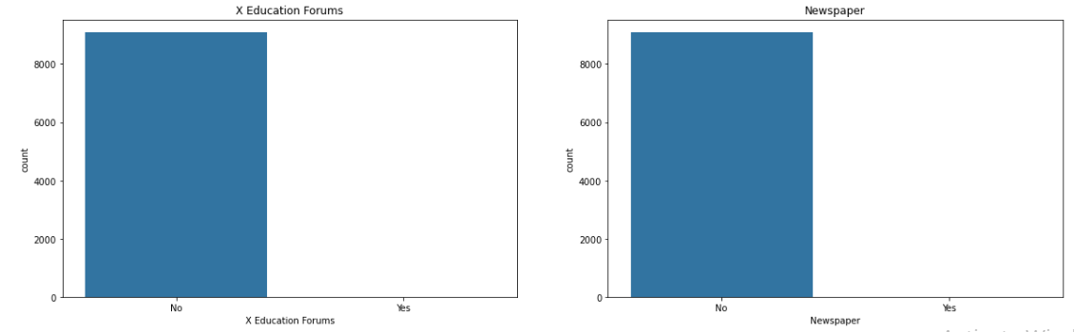

Slide 8
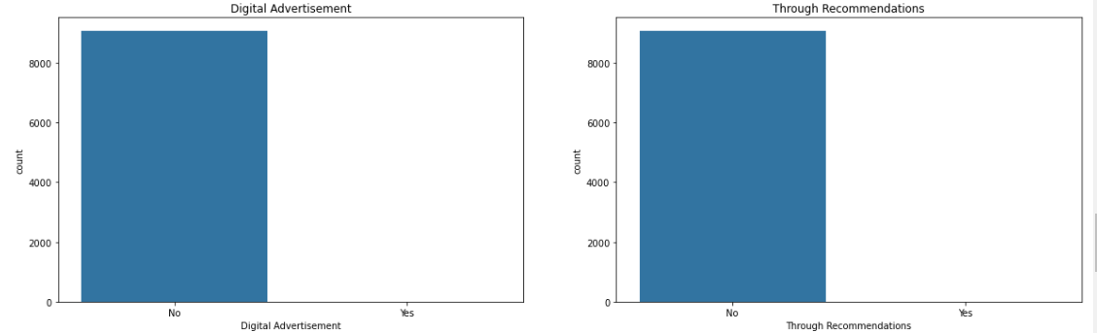
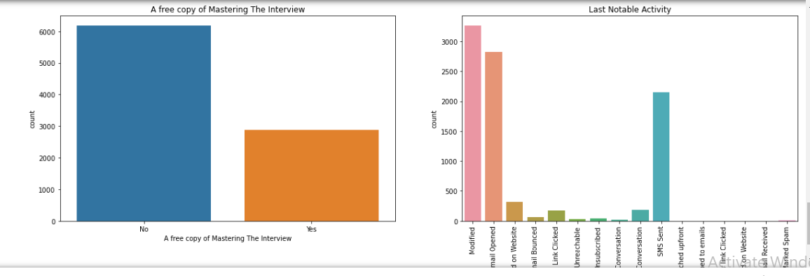

Slide 9
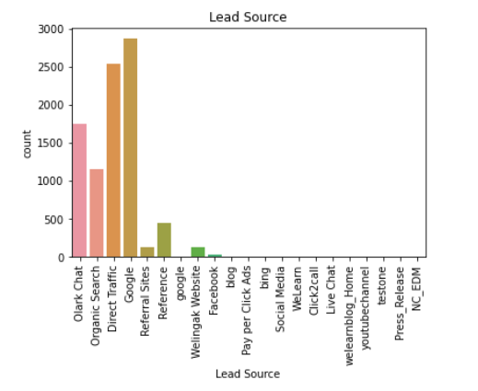
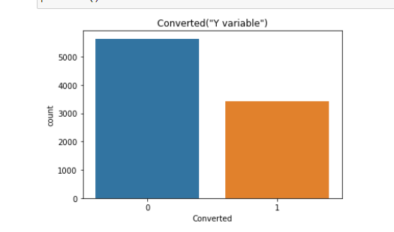

Slide 10
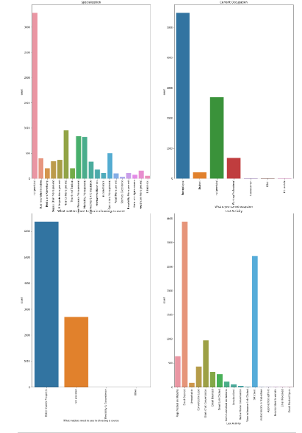

Slide 11
Inference Maximum number of leads are generated by Google and Direct traffic. Conversion Rate of reference leads and leads through welingak website is high. To improve overall lead conversion rate, focus should be on improving lead converion of olark chat, organic search, direct traffic, and google leads and generate more leads from reference and welingak website.

Slide 12
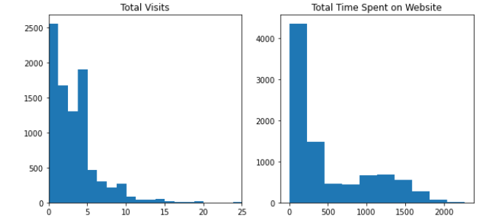
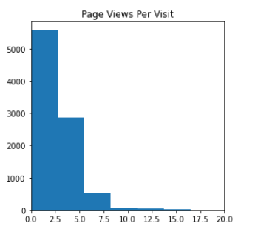
Numerical Variables

Slide 13
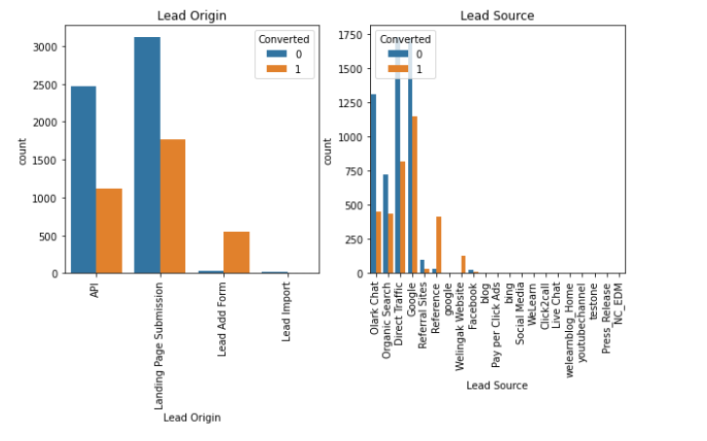
Inference
1. API and Landing Page Submission bring higher number of leads as well as conversion.
2. Lead Add Form has a very high conversion rate but count of leads are not very high.
3. Lead Import and Quick Add Form get very few leads.
4. In order to improve overall lead conversion rate, we have to improve lead conversion of API
and Landing Page Submission origin and generate more leads from Lead Add Form.

Slide 14
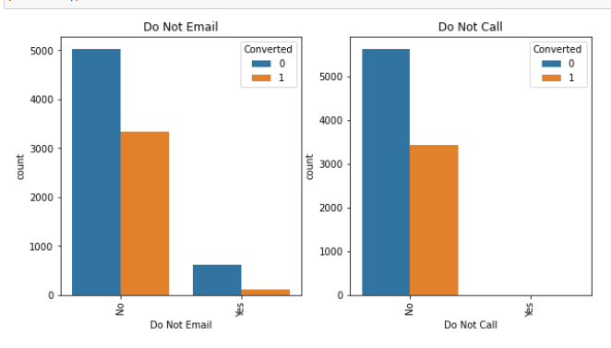

Slide 15
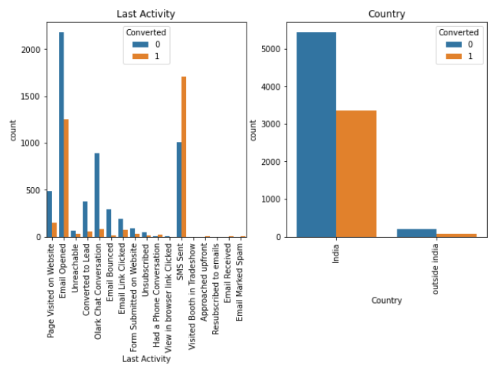

Slide 16
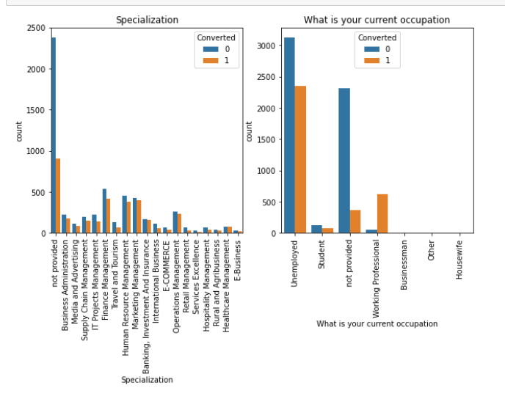

Slide 17
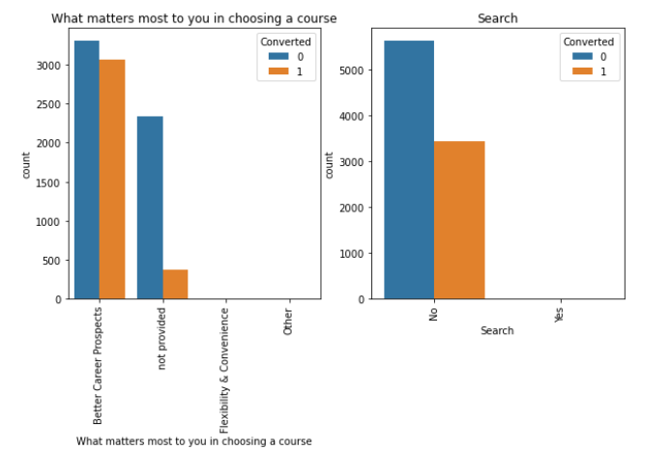

Slide 18
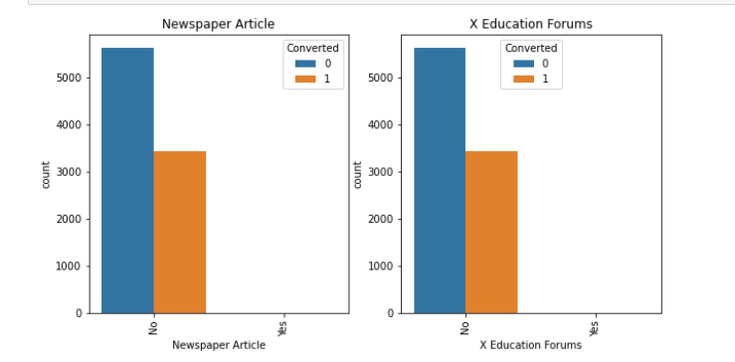

Slide 19
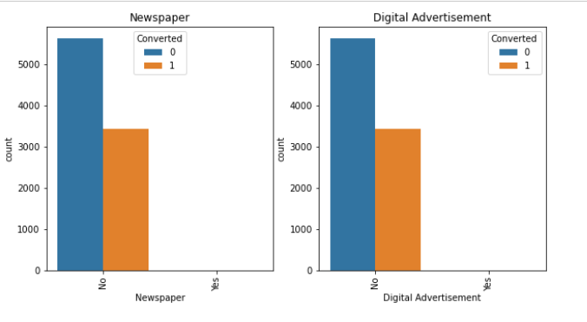

Slide 20
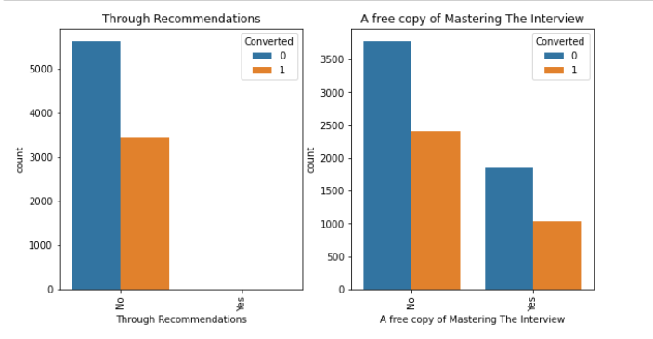
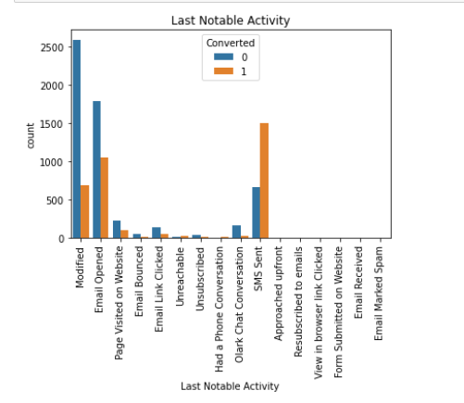

Slide 21
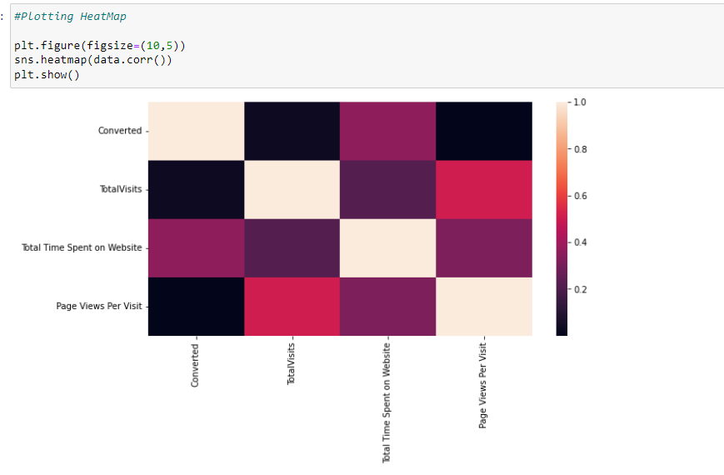

Slide 22
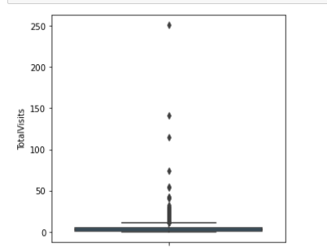
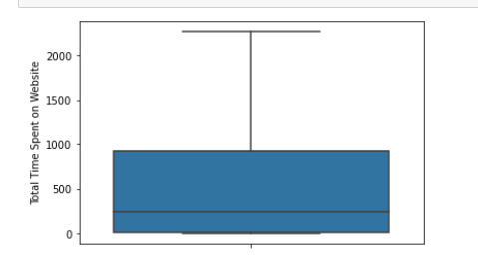
Outlier

Slide 23
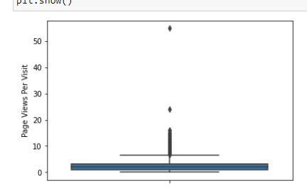
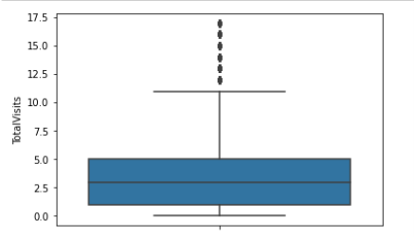
Inference Median for converted and not converted leads are the close. Nothng conclusive can be said on the basis of Total Visits

Slide 24
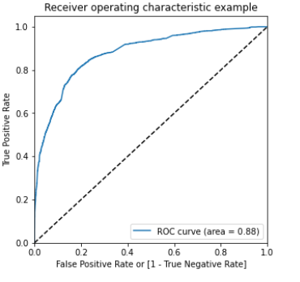
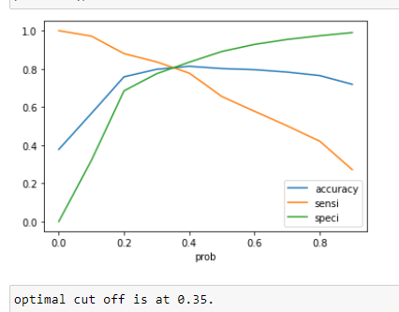
ROC Curve

Slide 25
CONCLUSION
While we have checked both Sensitivity-Specificity as well as Precision and Recall Metrics, we have considered the optimal cut off based on Sensitivity and Specificity for calculating the final prediction. –
Accuracy, Sensitivity and Specificity values of test set are around 81%, 79% and 82% which are approximately closer to the respective values calculated using trained set.
Also the lead score calculated shows the conversion rate on the final predicted model is around 80% (in train set) and 79% in test set
The top 3 variables that contribute for lead getting converted in the model are
Total time spent on website
Lead Add Form from Lead Origin
Had a Phone Conversation from Last Notable Activity
Hence overall this model seems to be good.

Slide 26
Business Analysis for converting Leads
Telephonic conversations have the capacity to make the conversion rate higher. This shows that “Human Touch” is still very important in connecting with the Leads. This is turn, directs the company to make their “Sales and Marketing Team“capable enough to provide all the necessary guidance and assistance required by the Leads.
Leads who spend more time on website are the most likely to become the future learners. This criterion requires the website to be designed in a way which is easy to navigate and provide the necessary information to the person logged in.

